Slide 1
Examples from previous years

Slide 2
Intervention research in child development has repeatedly produced a paradoxical conclusion: In correlational studies, parental assistance with children’s homework has been associated with lower academic achievement. As a result, some psychologists have concluded in published reports that parents should not help their children with homework…

Slide 3
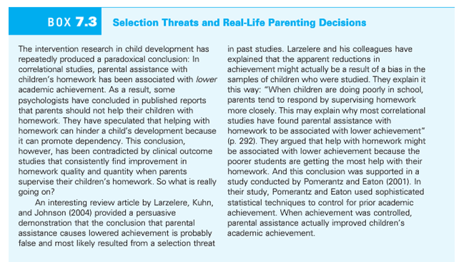

Slide 4
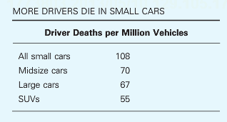
Multiple accounts consistent with the data
Large cars are safer than small cars
Small cars are more dangerous than large cars
Safest cars: Acura RX SUV, Acura RL sedan, Audi 4
Most dangerous cars: Chevy Cobalt, Ford Focus, Mazda 3

Slide 5
Niedenthal & Setterlund (1994) hypothesized that emotions influence perception, that is, our feelings influence the way we see the world. The researchers used music to induce either a happy or sad mood. “Eine Kleine Nachtmusik” by Mozart was used to put one group of subjects in a happy mood. “Adagio for Strings” by Barber was used to put another group of participants in a sad mood. After listening to the music, each participant’s mood was assessed to verify the effectiveness of the mood manipulation. Participants were then given a “lexical decision” task in which they were shown words or non-words (e.g., bragzap, crumdip). Amongst the words shown were 6 happy-related words: delight, cheer, joy, humor, harmony, comedy; and 6 sad-related words: weep despair, regret, hurt, frown, defeat. An interaction between group and word type was found that supported the hypothesis of the researchers that words congruent to mood would be identified more rapidly.

Slide 6
Hypothetical Data 1
What effects?
Main effects?
Interaction?

Slide 7
Hypothetical Data 2
What effects?
Main effects?
Interaction?

Slide 8
Wason Card Task
A
D
4
7
Hypothesis: If a card has a vowel on one side, then it has an even number on the other side.
Which cards do you turn over?

Slide 9
The Bar Bouncer task
Soda
Beer
16
22
Hypothesis: If a person is drinking beer, they must be 21 years or older…
Which cards do you turn over?

Slide 10
Selection threat: Homework
The intervention research in child development has repeated produced a paradoxical conclusion: in correlational studies, parental assistance with children’s homework has been associated with lower academic achievement. As a result, some psychologists have concluded in published reports that parents should not help their children with homework. They have speculated that helping with homework can hinder a child’s development because it can promote dependency. This conclusion, however, has been contradicted by clinical outcome studies that consistently find improvement in homework quality and quantity when parents supervise their children’s homework…

Slide 12
Sugar and hyperactivity in children
“Sugar rush”: candy, cake, etc., leads to high-activity behavior in children
Why do many people think this is true?
What is the role of experimental versus non-experimental data in this common belief?

Slide 13

Experimental Research on Sugar
How would we design a study to refute this idea?
What is the fundamental problem with our experimental approach?

Slide 14
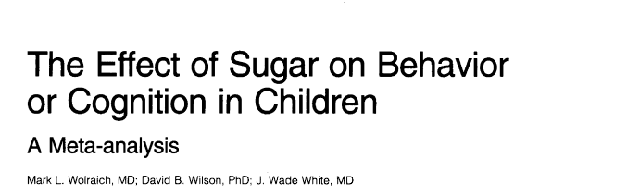
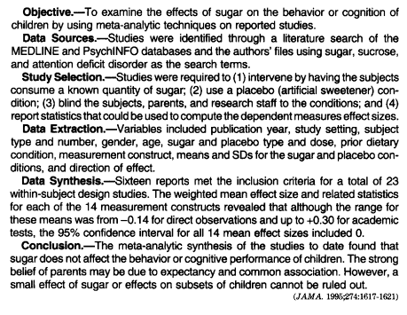
Meta-analysis: combined re-analysis of a set of published research studies
Provides additional sensitivity to small effect sizes
Can be used to argue for effect size = 0

Slide 15
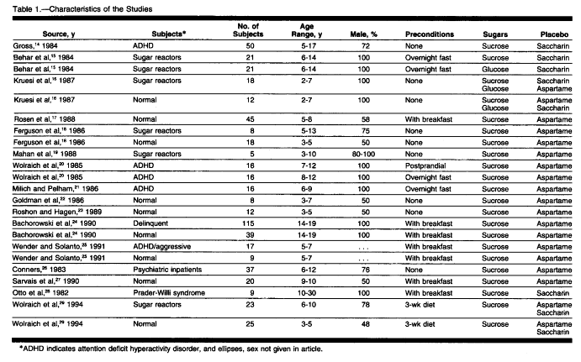

Slide 16
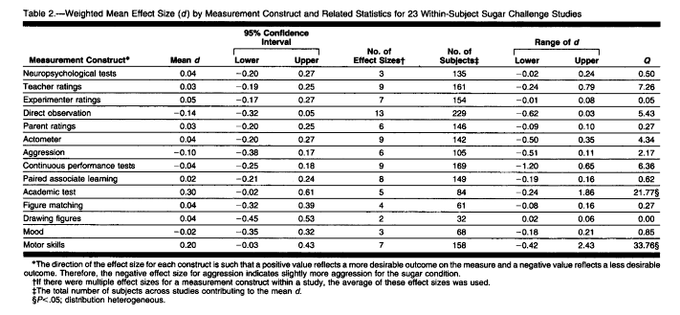

Slide 17
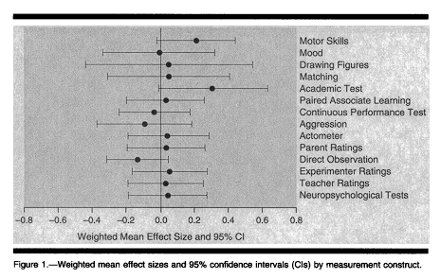
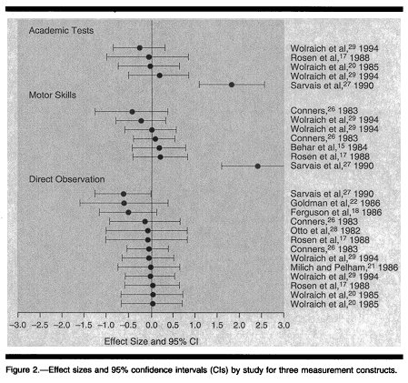
Forest Plots

